Slide 1
Detecting the real estate price
Esteem villas and co want to know the price of house in Bangalore area for their interest in buying and selling the property so they asked me to predict the price of house using the features of the data collected from there . We need to calculate price according to the feature that we can take like if the customer wants 2 bedroom and 1500 area / sqft and location of his/her need we need to deliver approximate price of that house task is to build a model that can predict the price of the house that the customer needs

Slide 2
Process
Collection of data
Analyzing the data
Describing the data
Cleaning the data
Finding outliers
Visualizing to find any irregularity
Splitting the data for training and testing
Training different model
Selecting which model to train the data
Training and testing
Predicting the price using the model

Slide 3
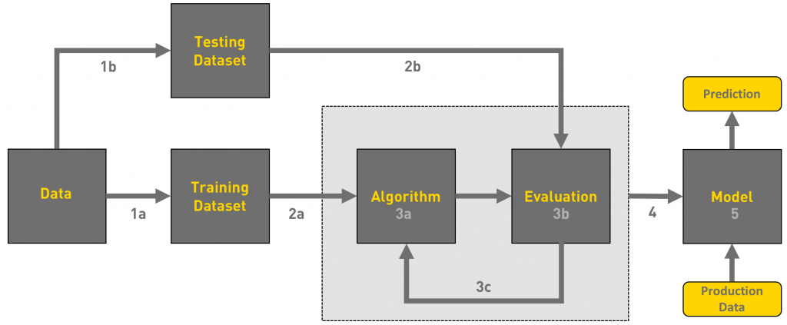
Visualized process

Slide 4
Models used
Linear regression: Linear regression is one of the easiest and most popular Machine Learning algorithms. It is a statistical method that is used for predictive analysis. Linear regression makes predictions for continuous/real or numeric variables such as sales, salary, age, product price, etc.
Extra tree regressor: An extra-trees regressor. This class implements a meta estimator that fits a number of randomized decision trees (extra-trees) on various sub-samples of the dataset and uses averaging to improve the predictive accuracy and control over-fitting.
GradientBoostingRegressor: Gradient boosting is a machine learning technique for regression and classification problems, which produces a prediction model in the form of an ensemble of weak prediction models, typically decision trees.
Random Forest: It takes less training time as compared to other algorithms. It predicts output with high accuracy, even for the large dataset it runs efficiently. It can also maintain accuracy when a large proportion of data is missing.

Slide 5
AdaBoost: can be used to boost the performance of any machine learning algorithm. It is best used with weak learners. These are models that achieve accuracy just above random chance on a classification problem. The most suited and therefore most common algorithm used with AdaBoost are decision trees with one level.
Decision tree: Decision Trees are a non-parametric supervised learning method used for both classification and regression tasks. The goal is to create a model that predicts the value of a target variable by learning simple decision rules inferred from the data features.

Slide 6
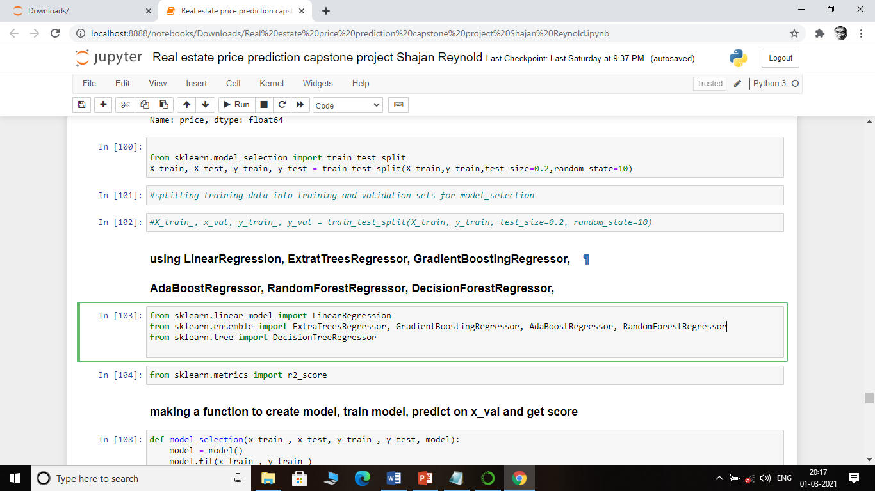

Slide 7
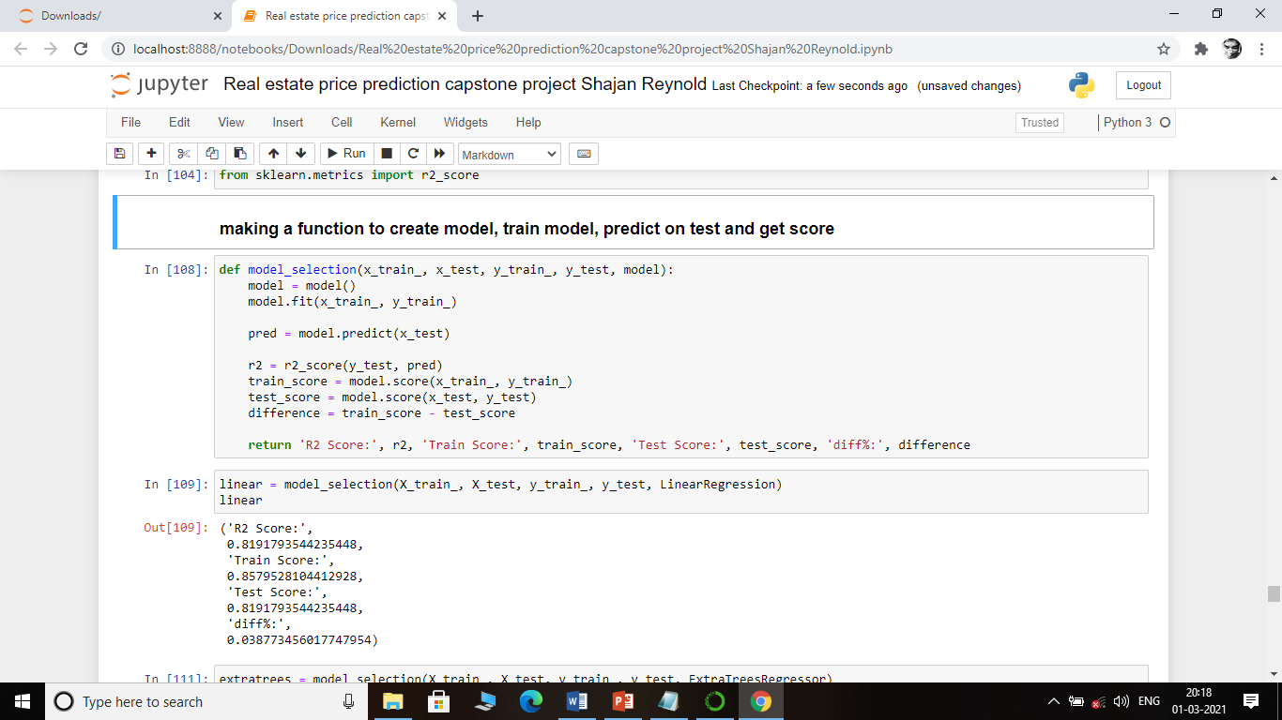
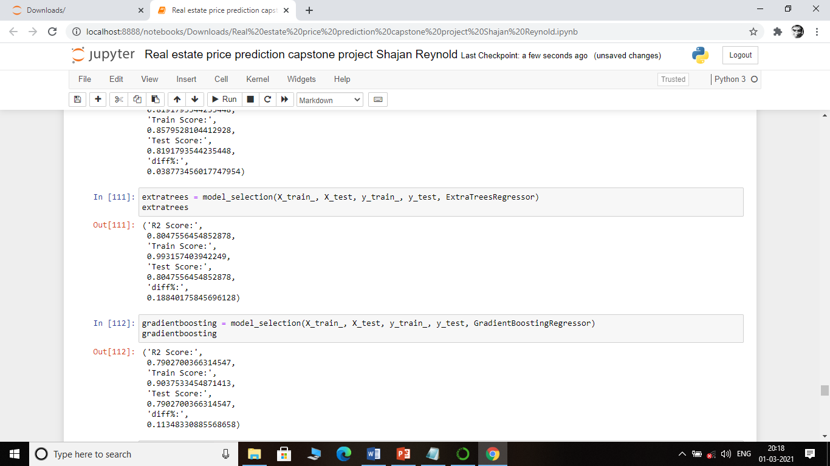

Slide 8
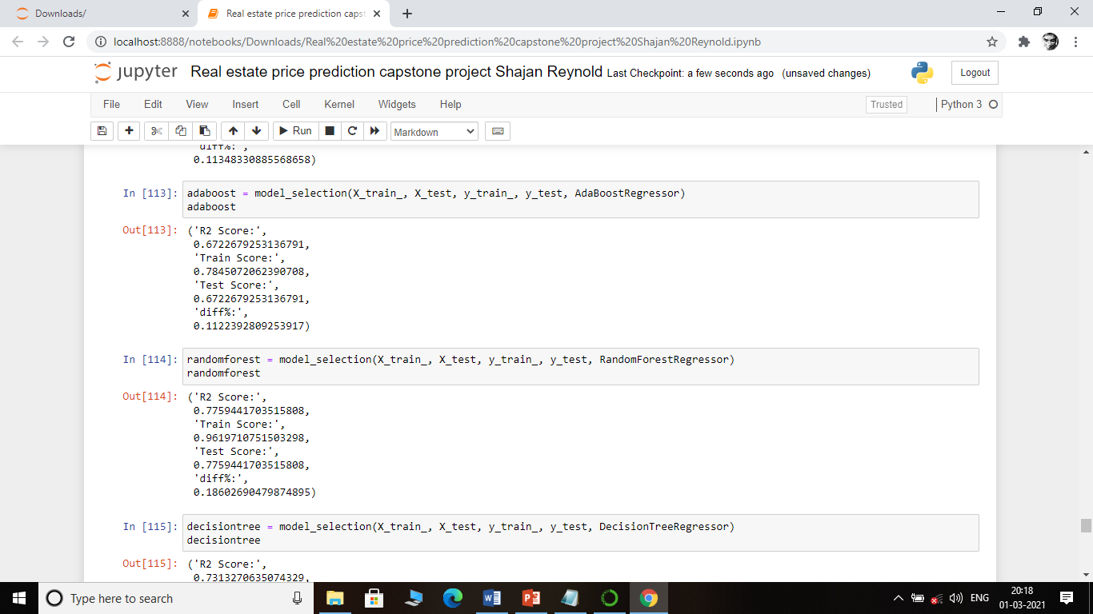
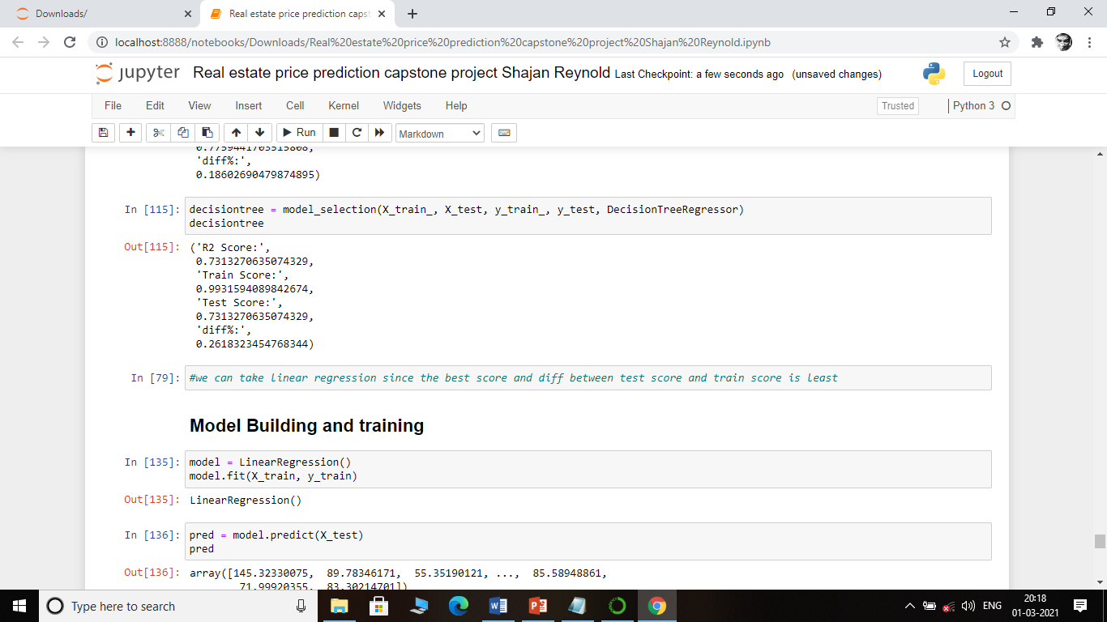

Slide 9
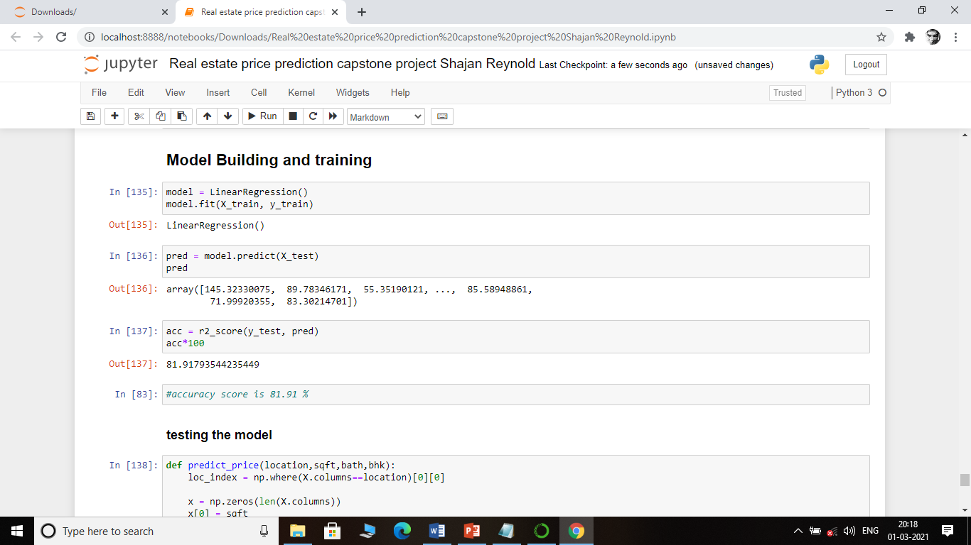

Slide 10
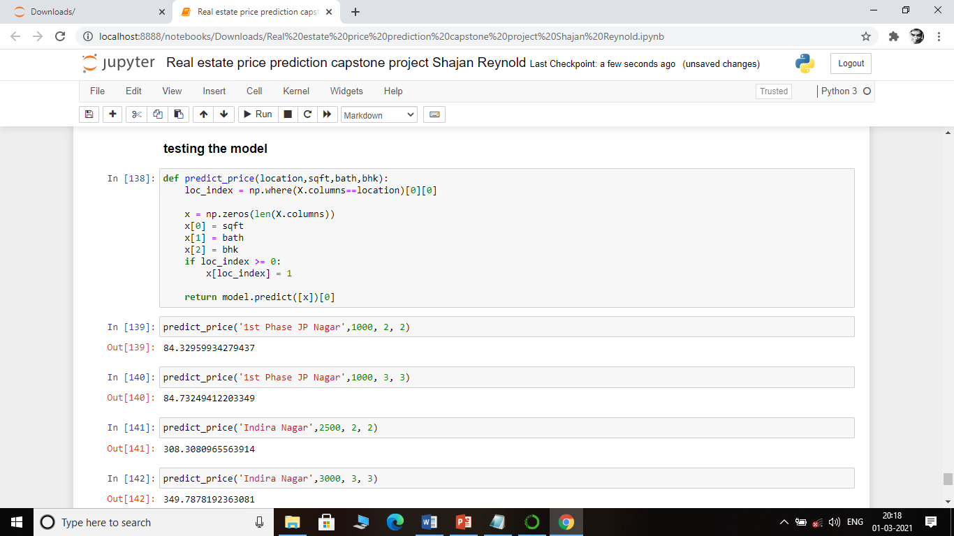

Slide 11
Conclusion
As a result, we can say, linear Regression is performing very well. Accuracy is almost 86%. we can predict the price of the house using this model
We can use such model for prediction purposes it may serve as good example for predict price sales and other such features.

Slide 12
Tools / Skills Used
Ms Excel
Python
Data analysis
Panda
Matplotlib
Seaborn
Machine learning

